Slide 1
Bit304 Final presentation BeautéPanda Android application for beauty enthusiasts
Ayu Chrisniyanti – E1500352
Lovely – E1500367

Slide 2
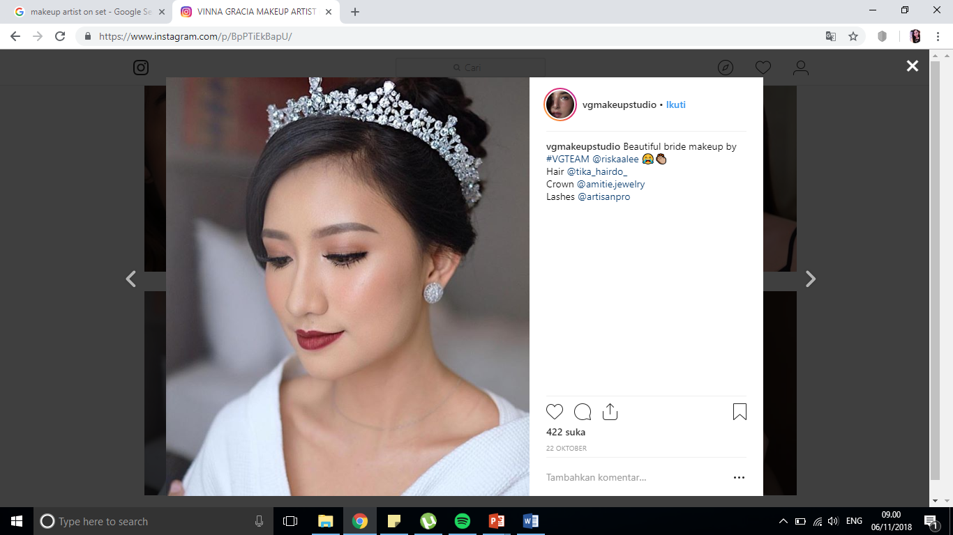
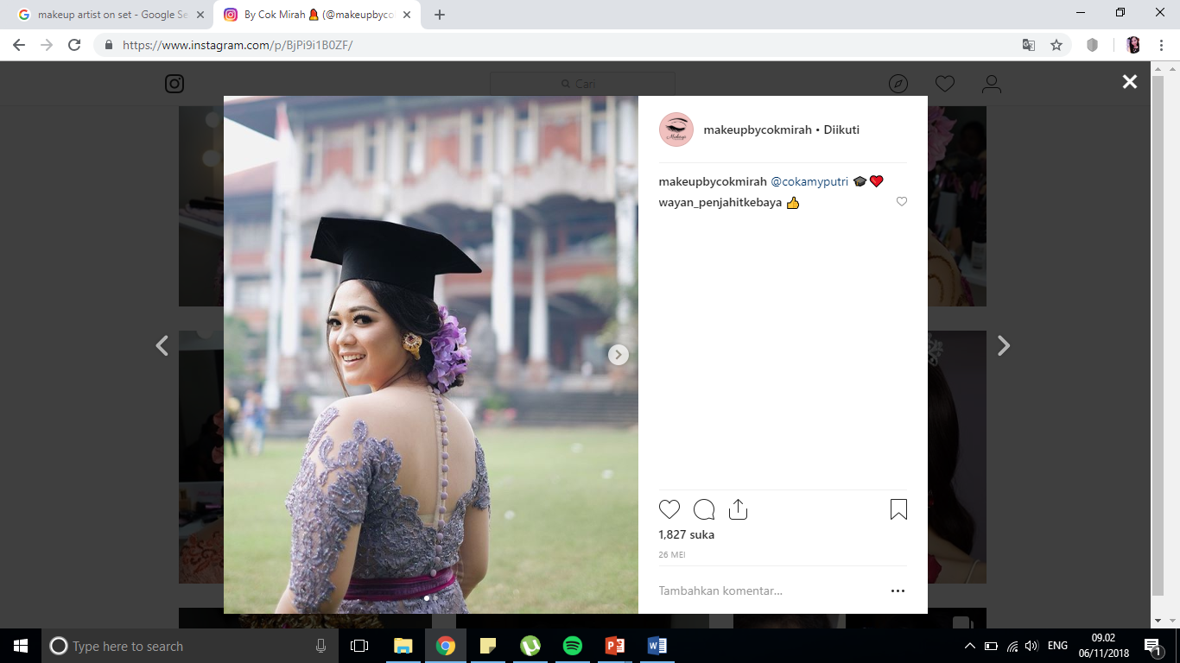
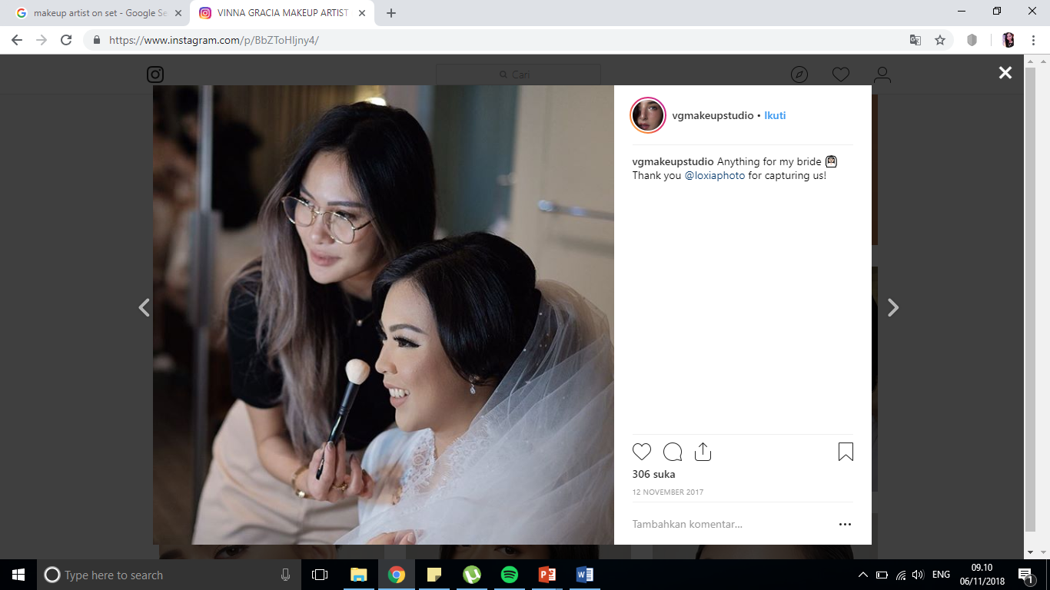
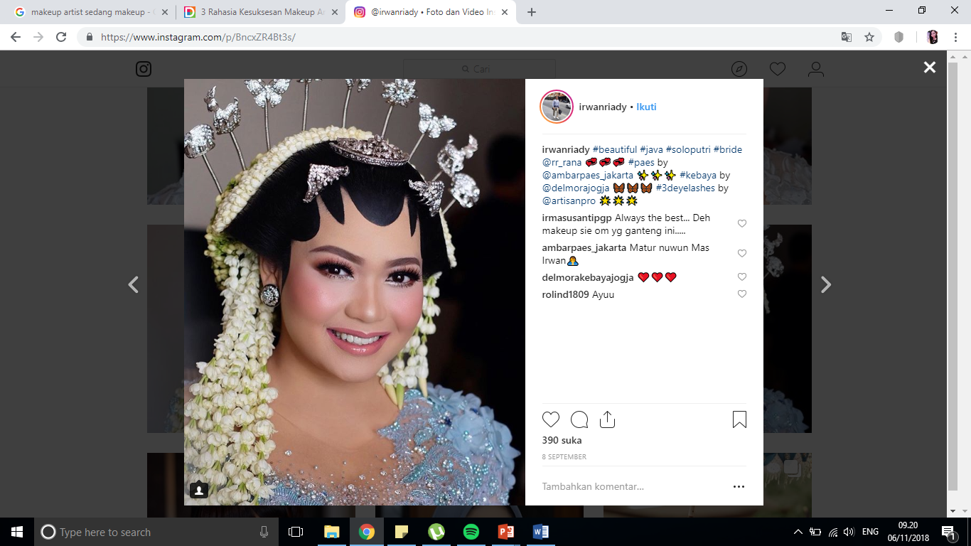
Project background
Makeup has become a necessity when women have to attend an event, such as wedding, graduation, birthday parties and many more.
However, not every woman can do their own makeup, so most of them prefer to find makeup artist or go to beauty salon to get their makeup done
Notes:
In Indonesia, and especially in Bali there are many traditional ceremonies that require specific makeup for women. So the demand for makeup artist will be higher

Slide 3
Project background
Nowadays, to find makeup artists, people usually search through social media such as Instagram and Facebook, for example by searching for hastags like #makeupartistsbali
But for more information, usually these makeup artists don’t want to give information through direct message in Instagram or Facebook, but through other application such as Whatsapp
It is still difficult to find makeup artists, compare them, and contact them within one application

Slide 4
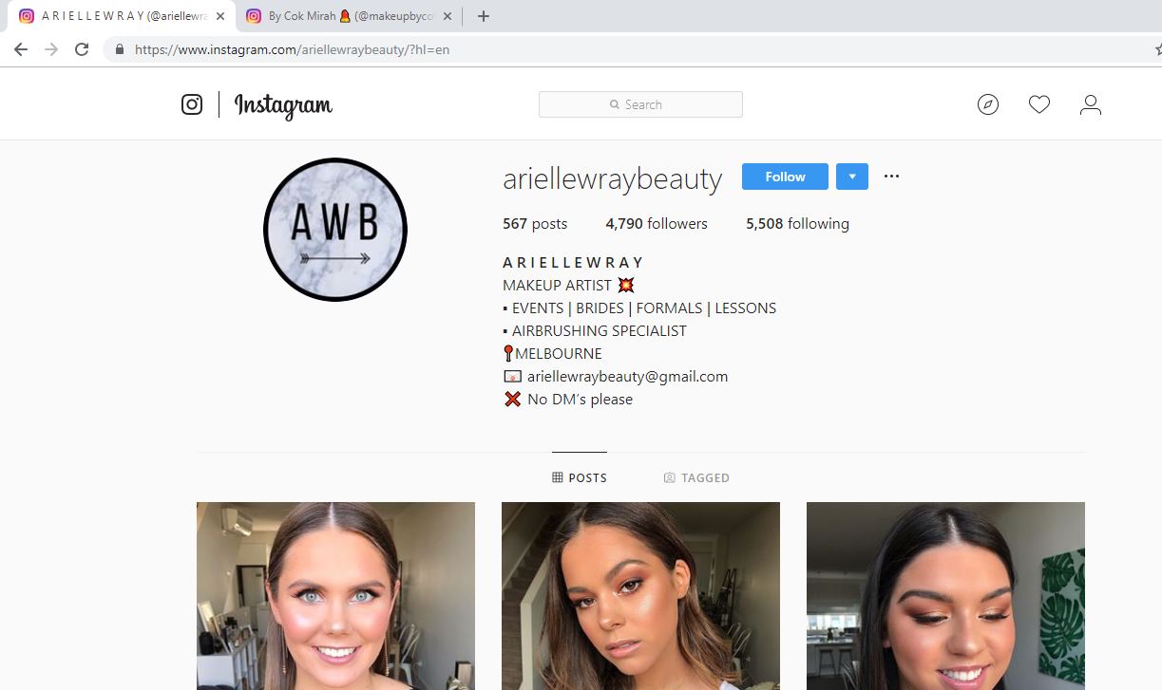
Notes:
This is the example of makeup artist that promotes herself through Instagram. But she will not reply direct message in Instagram, and only communicate with potential customers through email., which can be complicated. Although this example is not from Indonesia, but many Indonesian makeup artists do the same thing.
Because of this reason, we decide to create BeautePanda android application to solve this problem.

Slide 5
Project AIM
“To provide a platform for people who want to find makeup artists or beauty salons, and they can easily compare and contact the makeup artists”

Slide 6

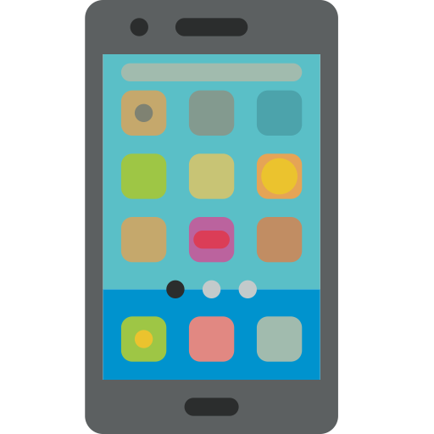
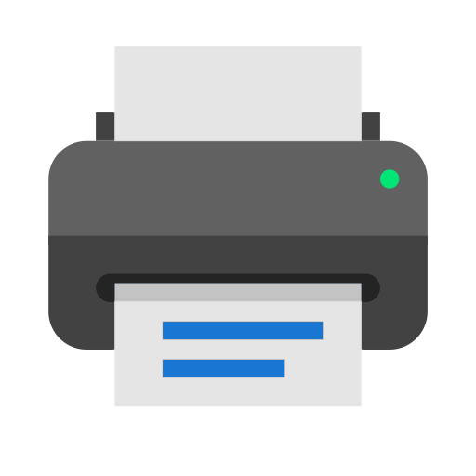
Hardware requirements
Notes:
Laptop: to develop the application
Samsung Galaxy A5 to test the application and ensure the application run properly
Printer: to print all the documents that are needed

Slide 7







software requirements
Notes:
IntelliJ IDEA: we use intellij idea as the IDE to develop the application
Android 5.0 Lollipop as the operating system because we develop an android application
Gantt Project: to make a project schedule and we can develop the project according to the schedule, so we can finish the project on time
Ms. Word: to make all of the documents that are needed
PPT: to make the material of presentation
Visio: to make use case diagram, sequence diagram and etc
Photoshop: to design our friendly and easy to use user interface

Slide 8
Literature review
Nowadays, Android Operating System is growing faster than iOS. Its market share is 48.8% which is wider than iOS where iOS only has 17.2% of market share.
Android offers all the developers with the ability to develop and build an innovative application. In 2011, Google announced that their Android apps had been about 100.000 installed around the world.

Slide 9
Literature review
The use of makeup artists have started from the Egyptians time.
In the 20th century, makeup artistry began to gain acceptance as a real profession due to popularity in cinematographic and fashion shows.
Now in the 21st century, cosmetics are affordable and used by women from every social class.

Slide 10
Current practices
Using social media to find the accounts of makeup artists and contact them through other application such as whatsapp, Line, etc.
Ask recommendation from family members or friends to find a good makeup artists or salons
Cannot contact, view and make appointment with the makeup artists’ portfolio from one application

Slide 11
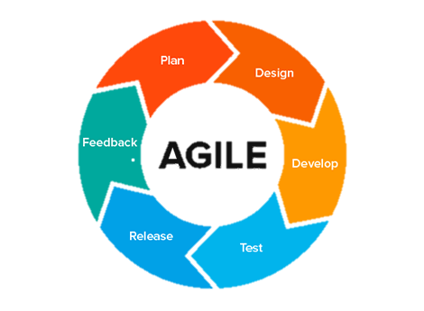
Methodology used – Agile
Notes:
Agile is suitable for mobile application development because it is based on people and embracing their changing needs.
It is a good approach for flexible and turbulent environment such as mobile market, where changes can happen anytime.
Moreover, the team that develop the application using agile should have a main focus towards fulfilling customer requirements.

Slide 12
Challenges
Lack of experience in developing Android application
Designing user-friendly and easy-to-use interface
Notes:
In developing this project we have faced some challenges such as lack of experience in developing android application, because we never have learn android before
And in order to make the customer feel comfortable when using our app, we have to design UI that is friendly and easy to use

Slide 13
functionalities
Search and find makeup artists and beauty salons
Send messages to the makeup artists and make appointment
Give recommendation about the top-rated makeup artists
Give ratings and feedback
Report and remove inappropriate content
Give the latest news in the beauty industry
Notes:
So the customer can search the desire MUA using keyword on teh search box
Customer can send the message to MUA in order to ask more information and also confirm appointment that are made by MUA
Customer can give ratings and feedback on MUA portfolio and MUA can reply The feedback
Customer and MUA can report inappropriate content and only admin can remove it
Admin can give The latest beauty news

Slide 14
Uniqueness
User can find, contact and make appointment with makeup artists within one application
Allow direct interactions with makeup artists through direct messaging feature
Notes:
This application can help many people to find, make appointment with MUA in one apps since we know many user have to type or search manually MUA
2. Since in social media we have to contact the MUA in other application such as WA

Slide 15
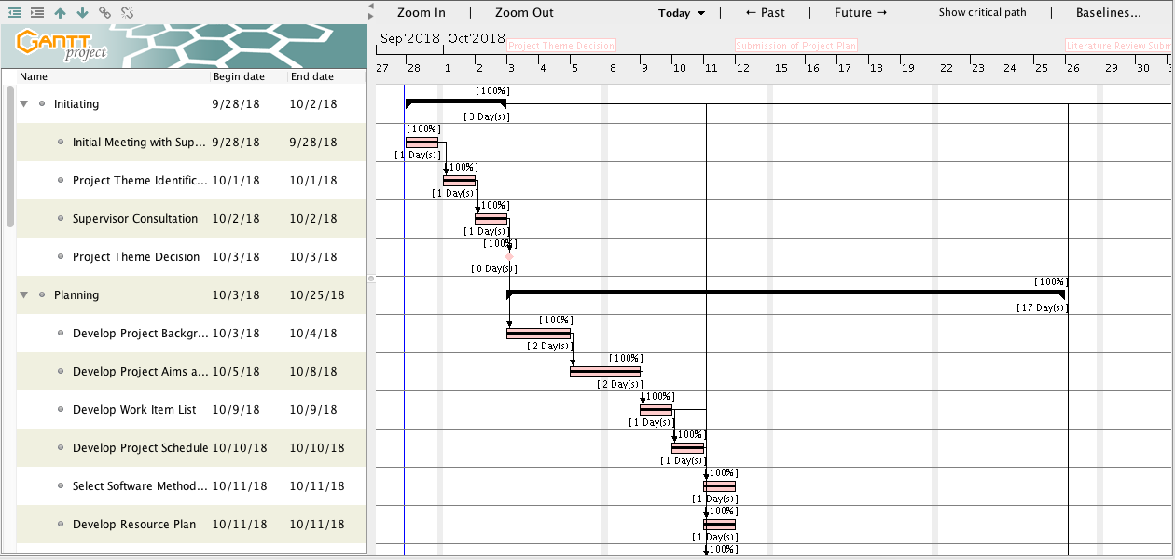
Gantt chart

Slide 16
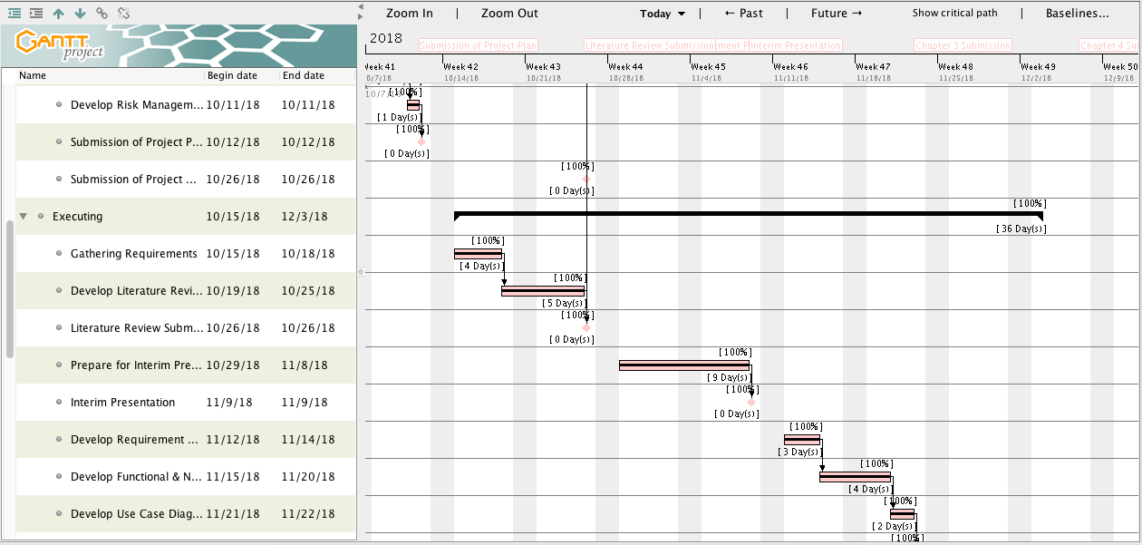
Gantt chart

Slide 17
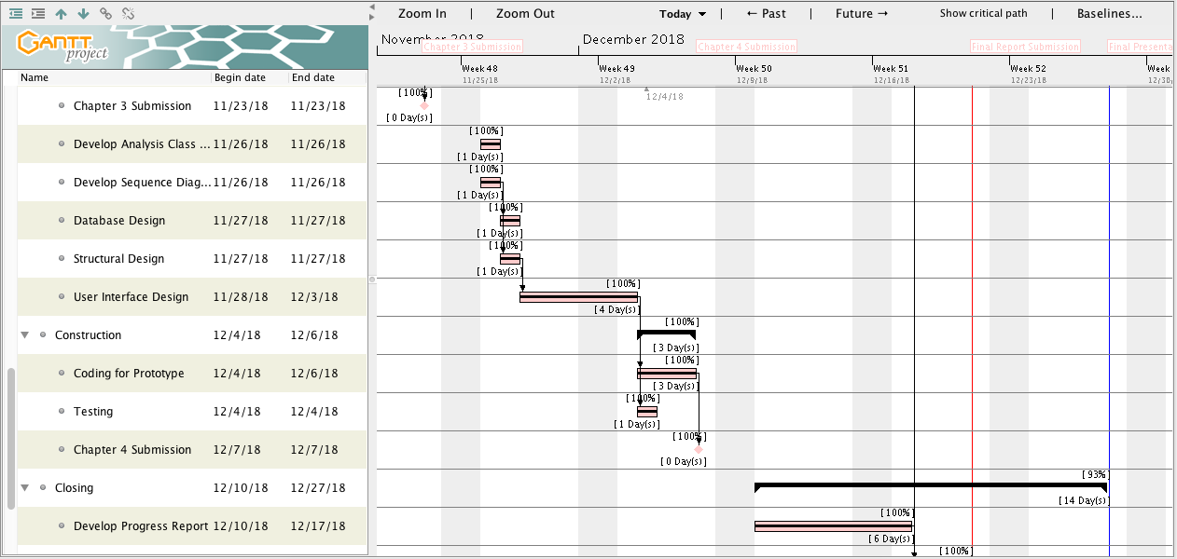
Gantt chart

Slide 18
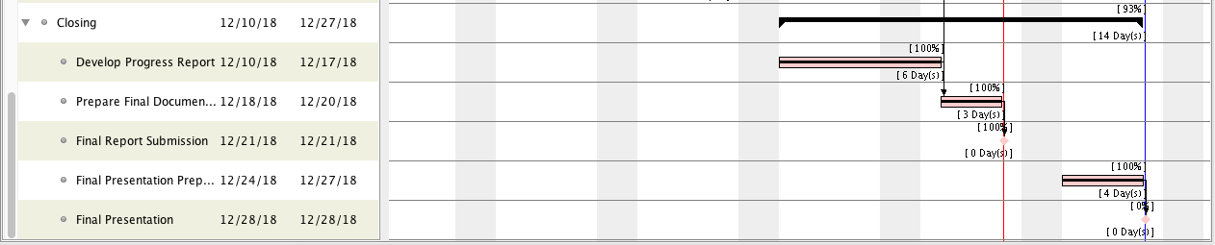
Gantt chart

Slide 19
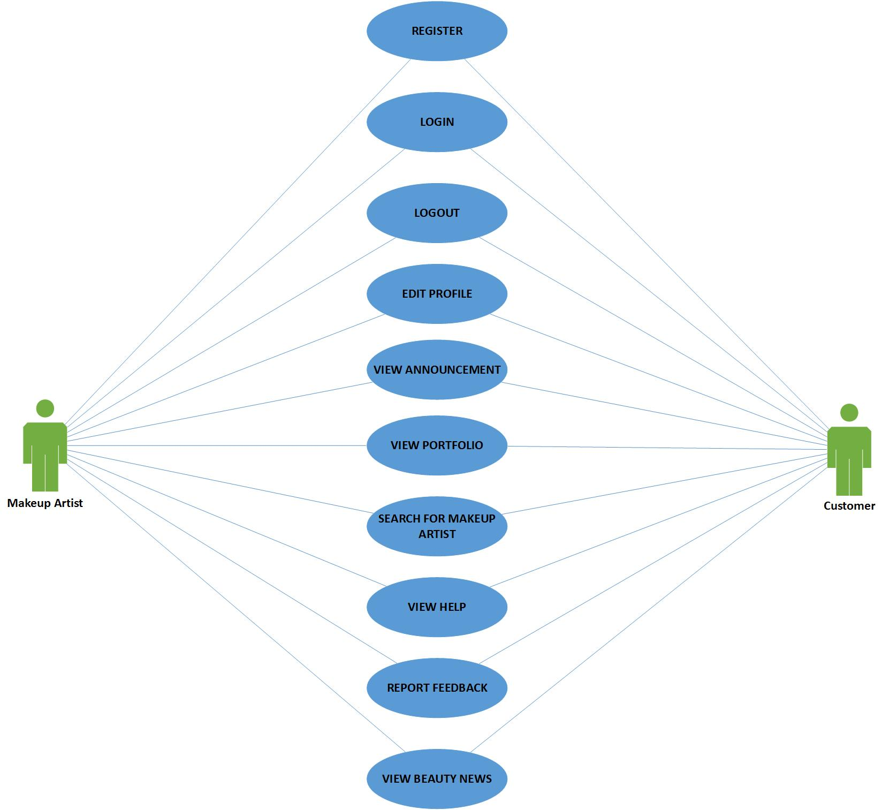
Use cases

Slide 20
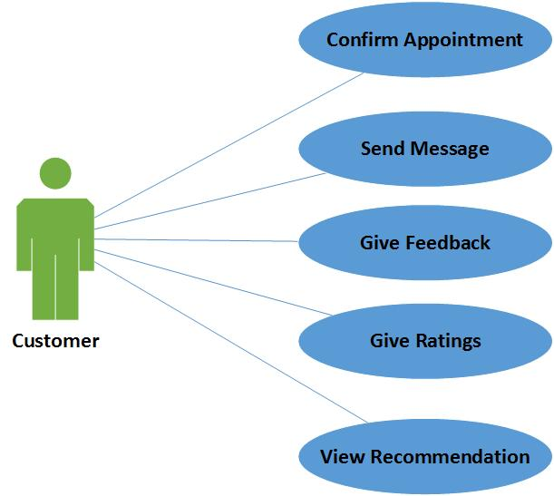
Use cases

Slide 21
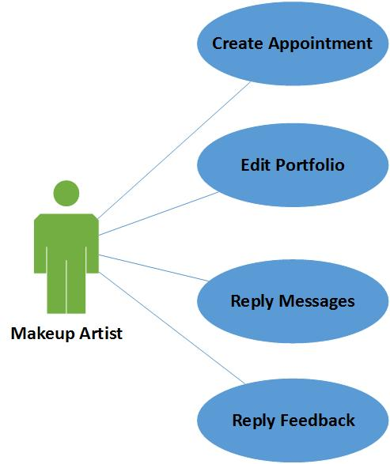
Use cases

Slide 22
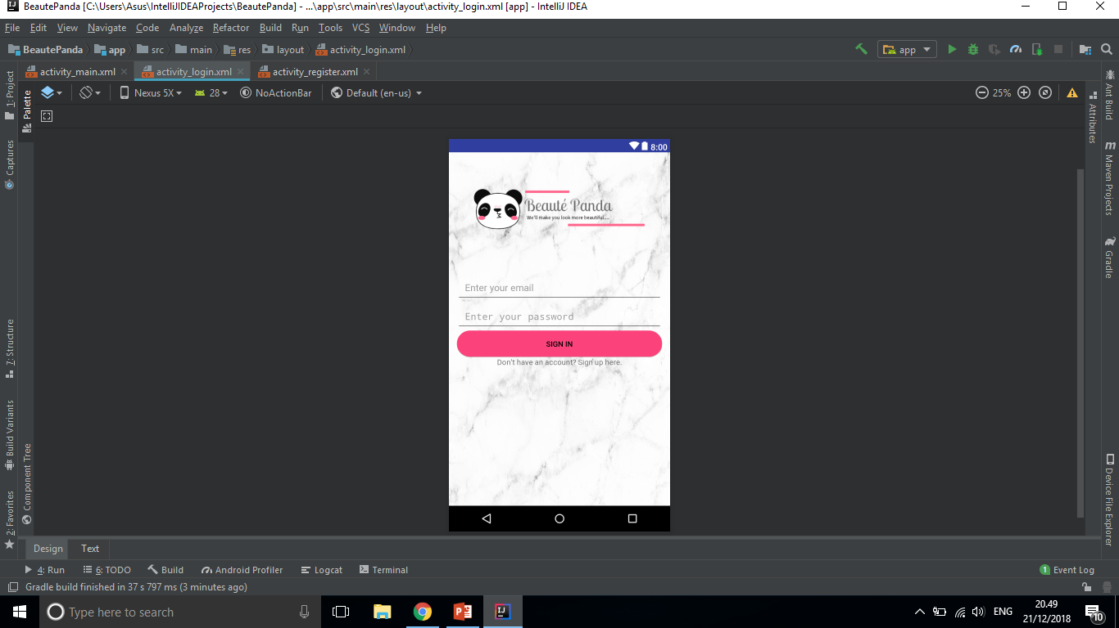
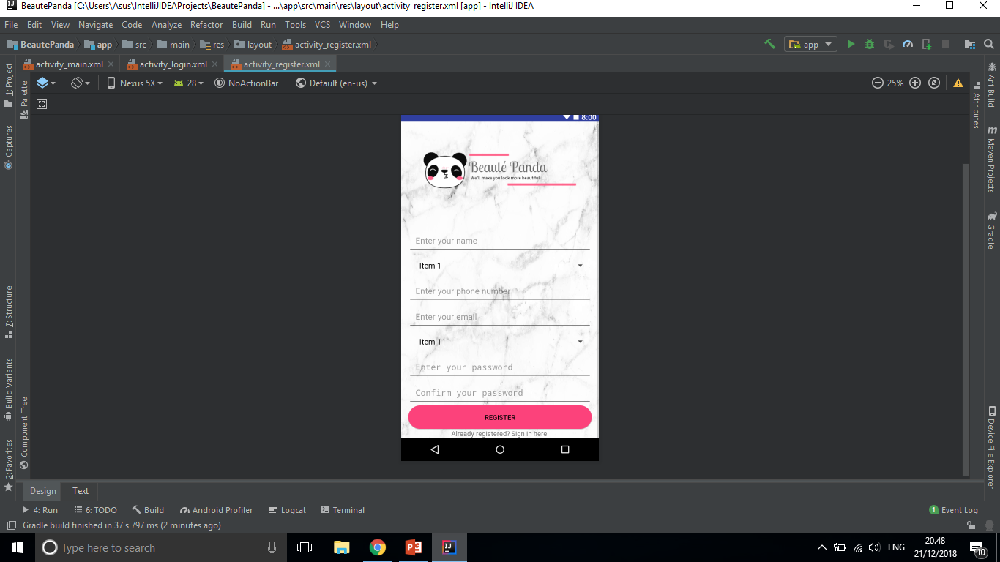
List of completed uses cases

Slide 23
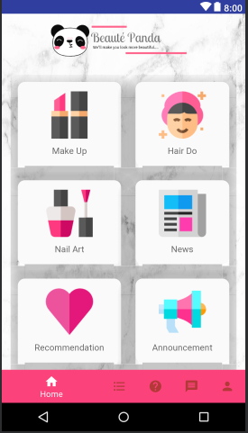
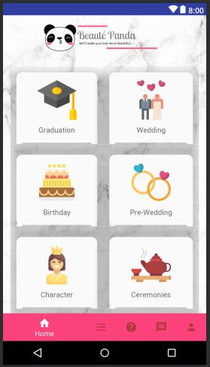
USER INTERFACE
Notes:
We provide some page menu for the user such as………
If The customer click the makeup button, The system will directly go to….
In this page The customer can choose The category of makeup
We use simple and flat to make The user interface look more attractive and simple
We also use flat and unique icon so it can be easily understood by The user

Slide 24

Completed Deliverables
Project Plan Literature Review
System Design Database Design
Interface Design Final Documentation
Prototype of the System

Slide 25
Shortcomings and solution
Ask seniors or friends that have developed Android application for guidance
Learn Android development tutorials on the Internet
Notes:
Beginning: the overcome of the problem that we have, which is lack of experience of developing android application, we have…
Do consultation with our supervisor

Slide 26
Future work
Completing the remaining use cases
Completing and submit final documentation for Final Year Project 2

Slide 27
Prototype

Slide 28
